Slide 1
CLOUD APPLICATIONS

Slide 2
CONTENTS
Scientific Applications
Healthcare- ECG analysis
Biology: Protein Structure prediction
Biology: Gene expression data analysis for cancer diagnosis
Geoscience: Satellite image processing
Business and consumer applications
CRM and ERP
Productivity
Social Networking
Media applications
Multiplayer online gaming

Slide 3
Introduction
Cloud computing has gained huge popularity in industry due to its ability to host applications for which the services can be delivered to consumers rapidly at minimal cost.
Applications from a range of domains, from scientific to engineering, gaming, and social networking, are considered.

Slide 4
Scientific Applications
Cloud computing systems meet the needs of different types of applications in the scientific domain: high-performance computing (HPC) applications, high-throughput computing (HTC) applications, and data-intensive applications
IaaS solutions- Virtual Machines- customizable
PaaS- . Applications have been redesigned and implemented on top of cloud programming application models and platforms to leverage their unique capabilities.
The MapReduce programming model provides scientists with a very simple and effective model for building applications that need to process large datasets

Slide 5
Healthcare
Healthcare is a domain in which computer technology has found several and diverse applications: from supporting the business functions to assisting scientists in developing solutions to cure diseases.
An important application is the use of cloud technologies to support doctors in providing more effective diagnostic processes.
Example: Electrocardiogram (ECG) data analysis on the cloud

Slide 6

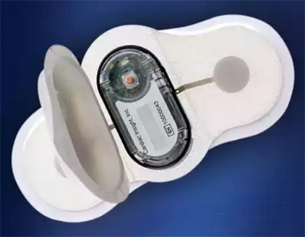
Healthcare: ECG analysis in the cloud

Slide 7

TAGecg Wearable ECG Sensor

Slide 8
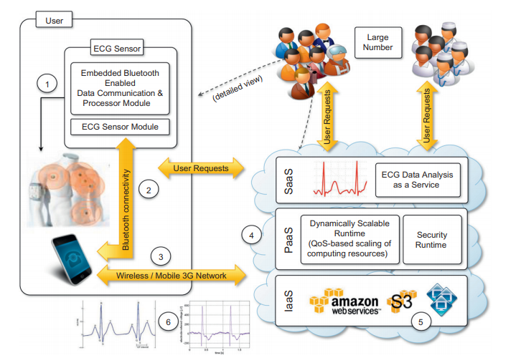
An online health monitoring system hosted in the cloud

Slide 9
Biology
Applications in biology often require high computing capabilities and often operate on large datasets that cause extensive I/O operations.
Because of these requirements, biology applications have often made extensive use of supercomputing and cluster computing infrastructures.
Example:
Protein structure prediction
Gene expression data analysis for cancer diagnosis

Slide 10

FROM DNA to Protein

Slide 11
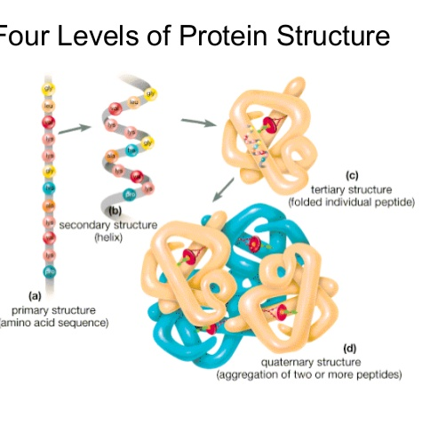
Protein structure prediction is a computationally intensive task that is fundamental to different types of research in the life sciences.
The geometric structure of a protein cannot be directly inferred from the sequence of genes that compose its structure, but it is the result of complex computations aimed at identifying the structure that minimizes the required energy.
This task requires the investigation of a space with a massive number of states, consequently creating a large number of computations for each of these states

Slide 12
One project that investigates the use of cloud technologies for protein structure prediction is Jeeva
An integrated Web portal that enables scientists to offload the prediction task to a computing cloud based on Aneka
These techniques translate the problem into one of pattern recognition, where a sequence has to be classified into one of three possible classes (E, H, and C)
A popular implementation based on support vector machines divides the pattern recognition problem into three phases: initialization, classification, and a final phase

Slide 13
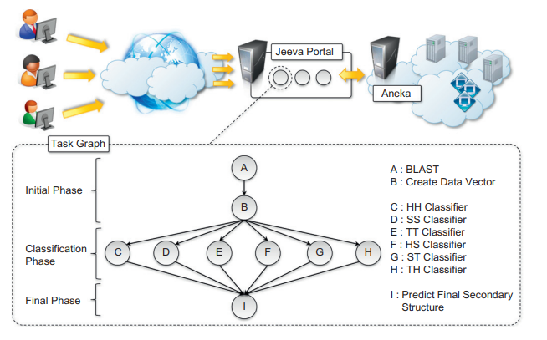
Architecture and overview of the Jeeva Portal

Slide 14
Gene expression data analysis for cancer diagnosis
Gene expression profiling is the measurement of the expression levels of thousands of genes at once.
It is used to understand the biological processes that are triggered by medical treatment at a cellular level.
Together with protein structure prediction, this activity is a fundamental component of drug design, since it allows scientists to identify the effects of a specific treatment.
Cancer is a disease characterized by uncontrolled cell growth and proliferation. This behaviour occurs because genes regulating the cell growth mutate

Slide 15
Gene expression profiling is utilized to provide a more accurate classification of tumours.
The classification of gene expression data samples into distinct classes is a challenging task.
The dimensionality of typical gene expression datasets ranges from several thousands to over tens of thousands of genes.
CoXCS has proven to be effective in these conditions.
CoXCS divides the entire search space into subdomains and employs the standard XCS algorithm in each of these subdomains.
Such a process is computationally intensive but can be easily parallelized because the classifications problems on the subdomains can be solved concurrently.
The number of required compute resources to execute it can vary over time. Therefore, the use of scalable middleware such as Aneka offers a distinctive advantage.

Slide 16
Geoscience
Geoscience applications collect, produce, and analyze massive amounts of geospatial and nonspatial data.
The geographic information system (GIS) is a major element of geoscience applications
GIS applications capture, store, manipulate, analyse, manage, and present all types of geographically referenced data.
This type of information is now becoming increasingly relevant to a wide variety of application domains: from advanced farming to civil security and natural resources management.
As a result, a considerable amount of geo-referenced data is ingested into computer systems for further processing and analysis

Slide 17
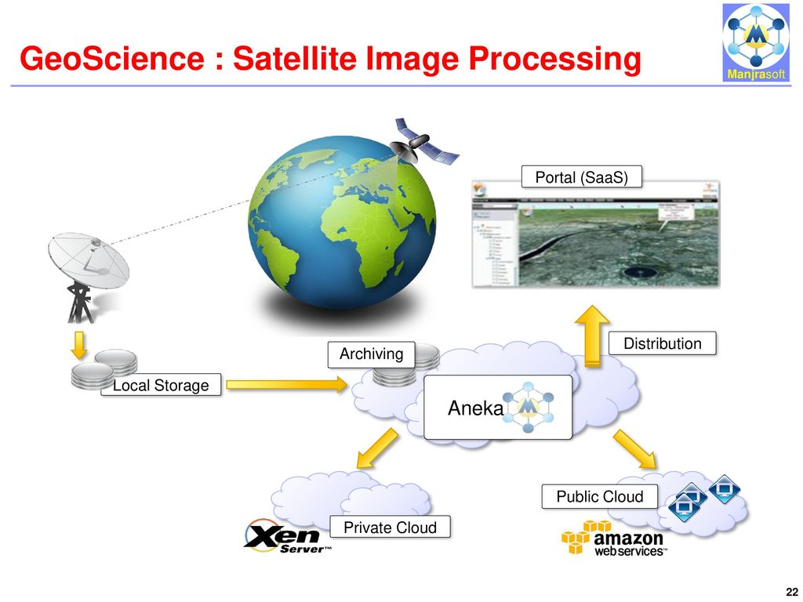
Geoscience: Satellite image processing

Slide 18
Business and consumer applications
The business and consumer sector is the one that probably benefits the most from cloud computing technologies.
On one hand, the opportunity to transform capital costs into operational costs makes clouds an attractive option for all enterprises that are IT-centric.
On the other hand, the sense of ubiquity that the cloud offers for accessing data and services makes it interesting for end users as well.
Moreover, the elastic nature of cloud technologies does not require huge up-front investments, thus allowing new ideas to be quickly translated into products and services that can comfortably grow with the demand.

Slide 19
CRM and ERP
CRM- Customer Relationship Management
Here are several features you can execute with a CRM system:
Automate and manage marketing campaigns
Analyse purchasing patterns
Offer high-quality customer support
Automate redundant tasks
Identify new leads
Streamline the sales process

Slide 20
ERP- Enterprise Resource Planning
Features you can utilize with an ERP system:
Enter business process information in real time
Get alerts about issues
Manage hiring initiatives
Track manufacturing and supply chains
Manage benefits, payroll and employee information
Create enterprise-wide strategies
Update accounts
Process orders

Slide 21
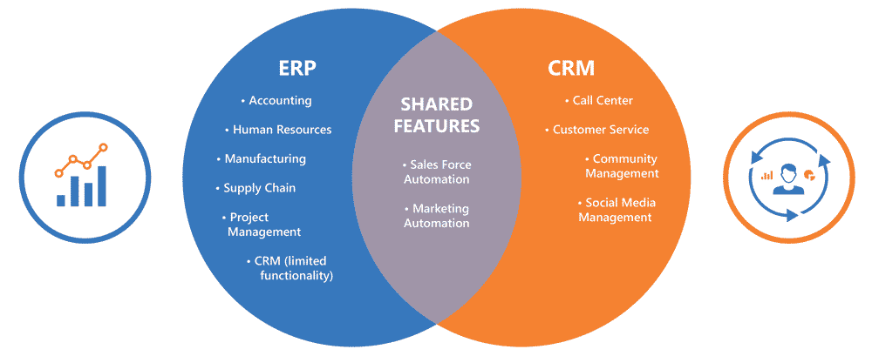
Despite the differences, a large part of the functionality of the two systems overlap each other

Slide 22
Popular companies in this area’s are:
Salesforce.com
Microsoft dynamics CRM
NetSuite

Slide 23
Salesforce.com
Salesforce.com is probably the most popular and developed CRM solution available today.
As of today more than 100,000 customers have chosen Safesforce.com to implement their CRM solutions.
The application provides customizable CRM solutions that can be integrated with additional features developed by third parties.
Salesforce.com is based on the Force.com cloud development platform.
This represents scalable and high-performance middleware executing all the operations of all Salesforce.com applications.

Slide 24


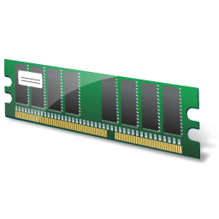







Force.com Platform
User-base 1: Application 1
Metadata Cache
Bulk Processing Engine
Metadata Tables (UDD)
Multitenant-aware Query Optimiser
Pivot Tables
Runtime Application Generator
Data Tables
Full-text Search Engine
Shared Database
User-base 2: Application 2
COMMON APPLICATION SCREENS
TENANT-SPECIFIC
SCREENS
OBJECTS (TABLES)
Indexes
Virtual Application Components
User-base 3: Application 3

Slide 25
PRODUCTIVITY
Productivity applications replicate in the cloud some of the most common tasks that we are used to performing on our desktop: from document storage to office automation and complete desktop environments hosted in the cloud.
Popular Examples:
Dropbox and iCloud
Google docs
Cloud desktops: EyeOS and XIOS/3
Social Networking: Facebook

Slide 26









Dropbox Folder
Automatic
synchronization
Dropbox Folder
Dropbox Folder

Slide 27

EyeOS installation

Slide 28



User
EyeOS Server
User
eyeos
apps
User
extern
extras
system
users
Client-side scripts
workgroups

Slide 29
Media applications
Media applications are a niche that has taken a considerable advantage from leveraging cloud computing technologies.
In particular, video-processing operations, such as encoding, transcoding, composition, and rendering, are good candidates for a cloud-based environment.
These are computationally intensive tasks that can be easily offloaded to cloud computing infrastructures.
Examples:
Animoto
Maya rendering with Aneka
Video encoding on the cloud: Encoding.com

Slide 30




EC2 instances:
web front end
Scalability engine
Amazon SQS
Amazon S3:
Video storage
EC2 instances: video rendering

Slide 31
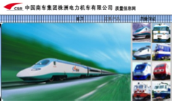
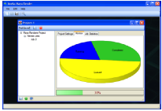
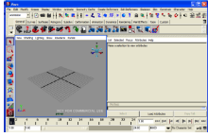
Aneka MayaRender
Render Tasks
Aneka
Render Files
Networked LAN
Scenarios
Maya: Train Design

Slide 32
Multiplayer online gaming
Online multiplayer gaming attracts millions of gamers around the world who share a common experience by playing together in a virtual environment that extends beyond the boundaries of a normal LAN.
Online games support hundreds of players in the same session, made possible by the specific architecture used to forward interactions, which is based on game log processing.
Players update the game server hosting the game session, and the server integrates all the updates into a log that is made available to all the players through a TCP port.
The client software used for the game connects to the log port and, by reading the log, updates the local user interface with the actions of other players

Slide 33
Gamer
Titan Gaming Portal
Aneka
Gamer
Gamer
Log
Processing Task
Game Server
Game Server
Log
Processing Task
Game Server
Log
Processing Task

Slide 34
Game log processing is also utilized to build statistics on players and rank them.
These features constitute the additional value of online gaming portals that attract more and more gamers.
The processing of game logs is a potentially compute-intensive operation that strongly depends on the number of players online and the number of games monitored.
Moreover, gaming portals are Web applications and therefore might suffer from the spiky behaviour of users that can randomly generate large amounts of volatile workloads that do not justify capacity planning

